Slide 1
Lecture 02

Slide 2
TAYLOR THEOREM
Motivation
Taylor Theorem
Examples

Slide 3
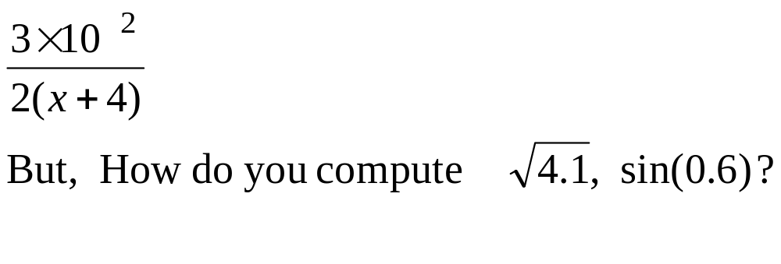
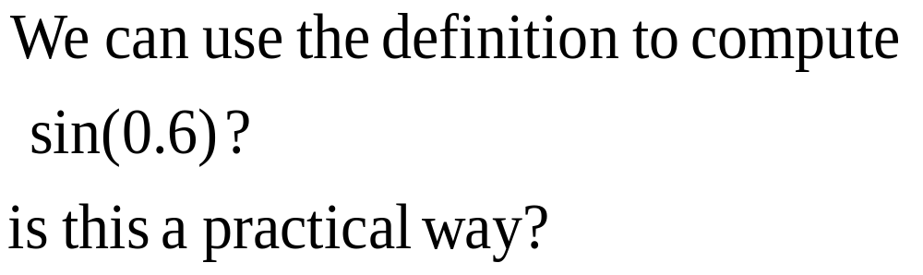
Motivation
We can easily compute expressions like
b
a
0.6

Slide 4
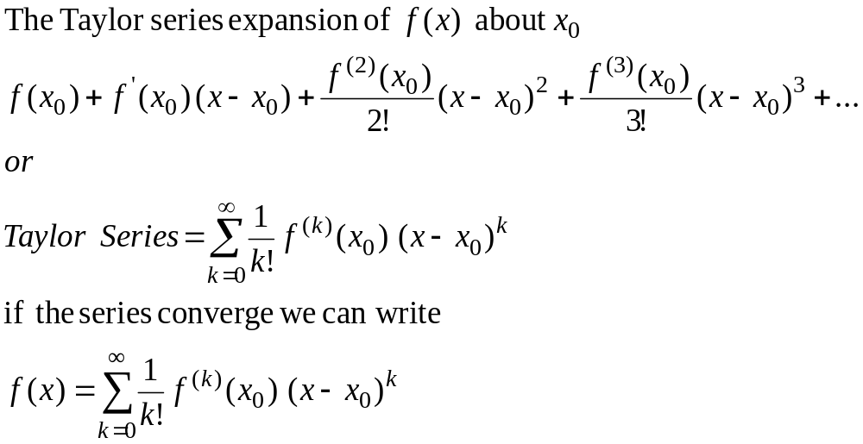
Taylor Series

Slide 5
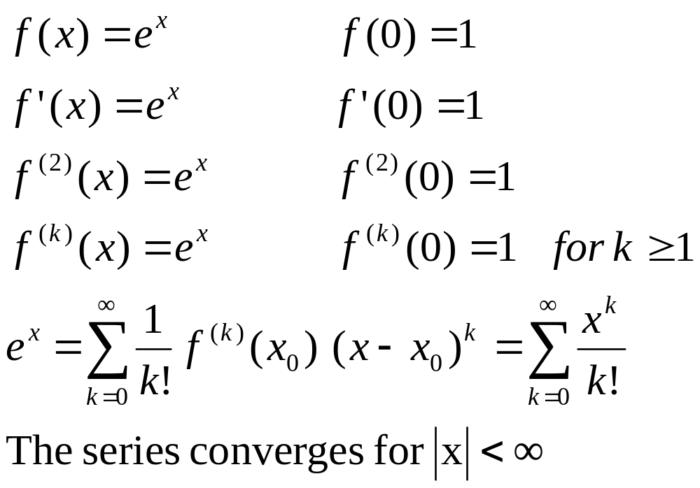
Example 1

Slide 6
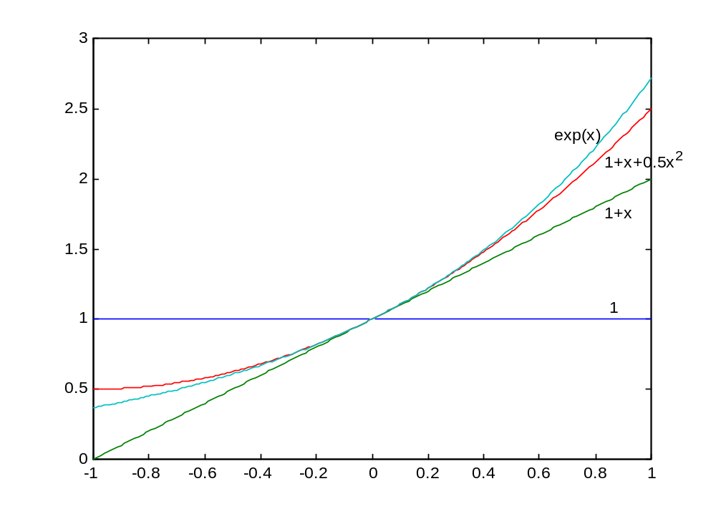

Slide 7
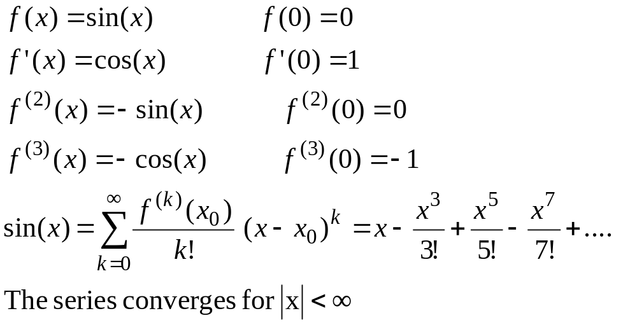
Example 2

Slide 8
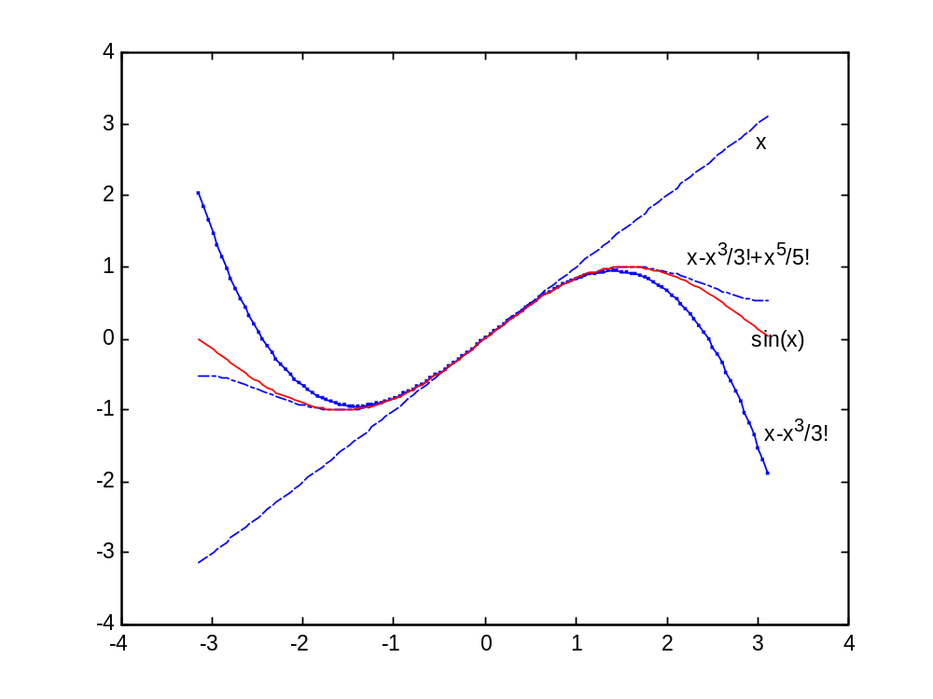

Slide 9
Convergence of Taylor Series
(Observations, Example 1)
The Taylor series converges fast (few terms are needed) when x is near the point of expansion. If |x-c| is large then more terms are needed to get good approximation.

Slide 10
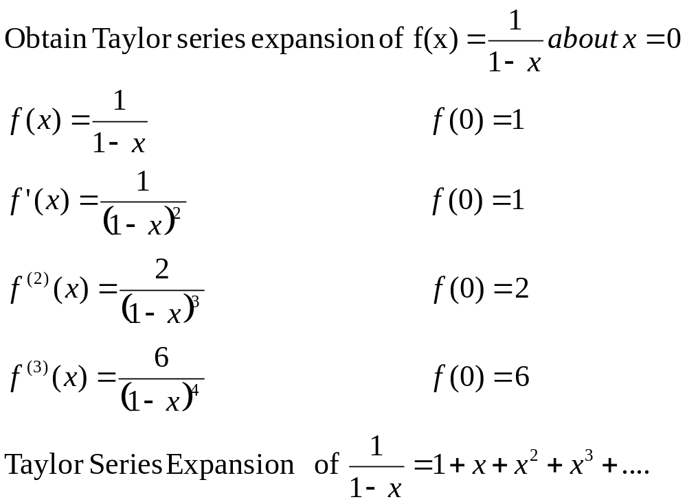
Example 3

Slide 11
Remarks
Can we apply Taylor series for x>1??
How many terms are needed to get good approximation???
These questions will be answered using Taylor Theorem

Slide 12
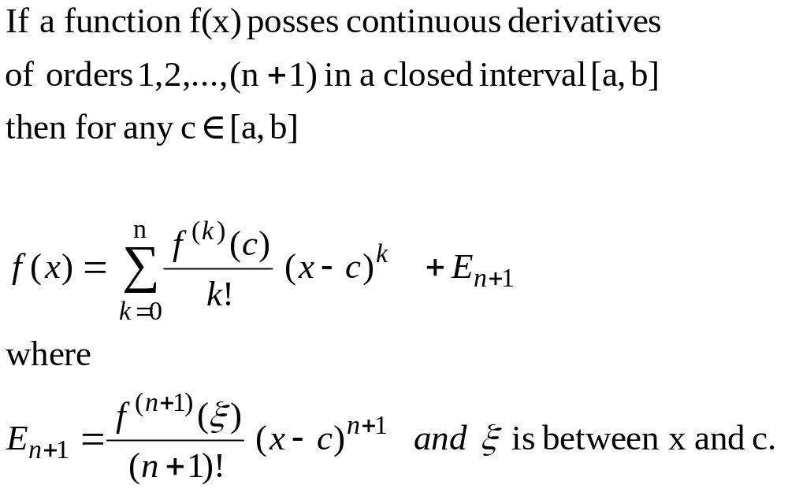
Taylor Theorem
(n+1) terms Truncated Taylor Series
Reminder

Slide 13
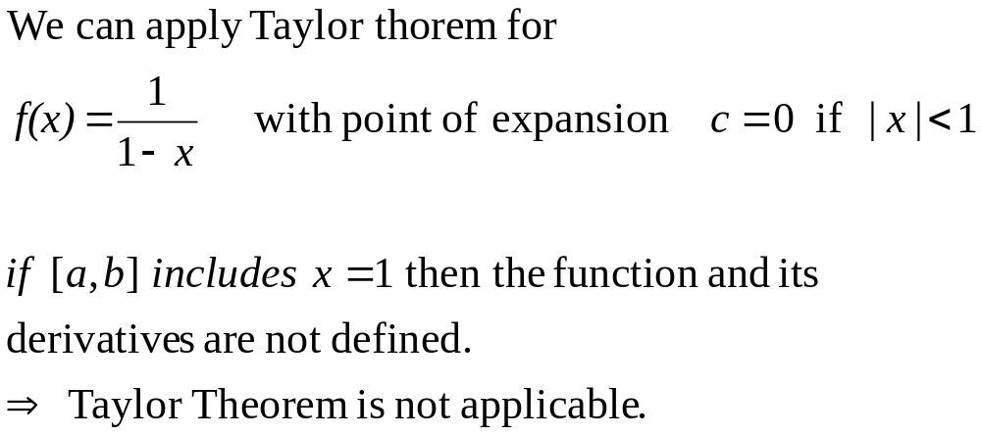
Taylor Theorem

Slide 14
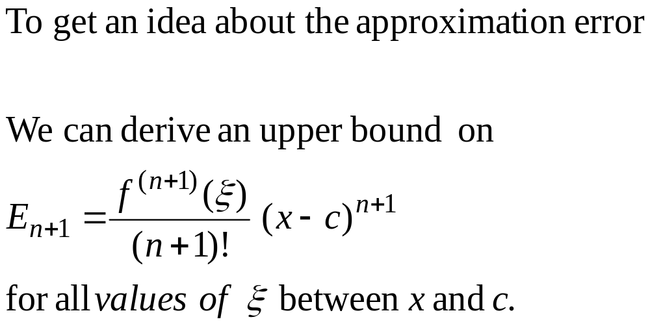
Error Term

Slide 15
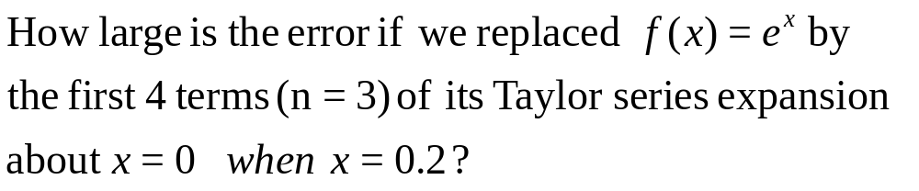
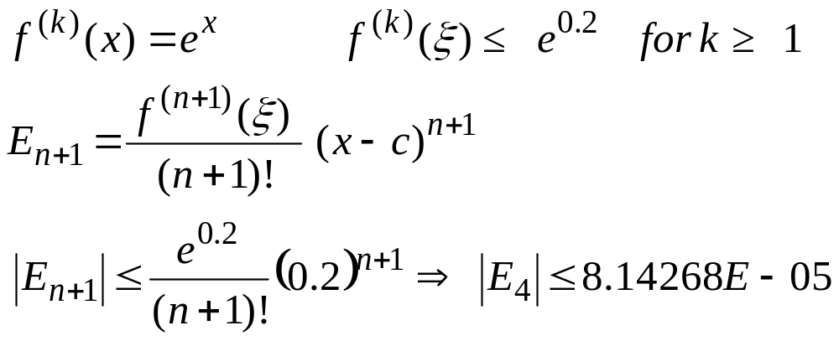
Example 4

Slide 16
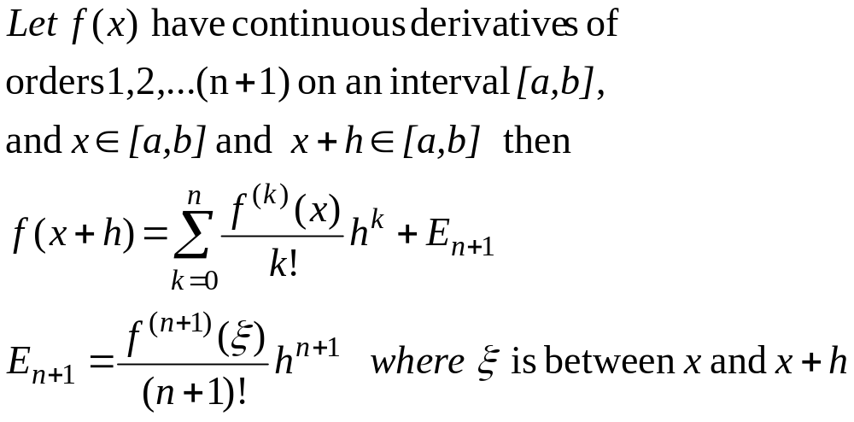
Alternative form of Taylor Theorem

Slide 17
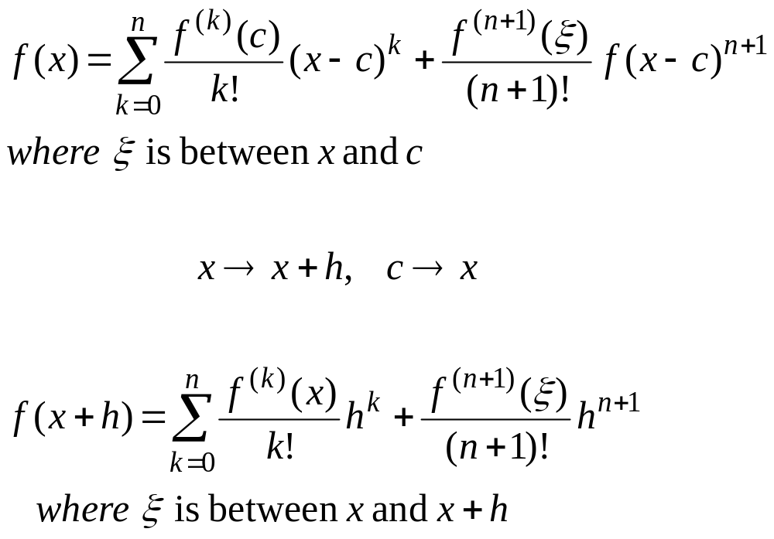
Taylor Theorem
Alternative forms

Slide 18
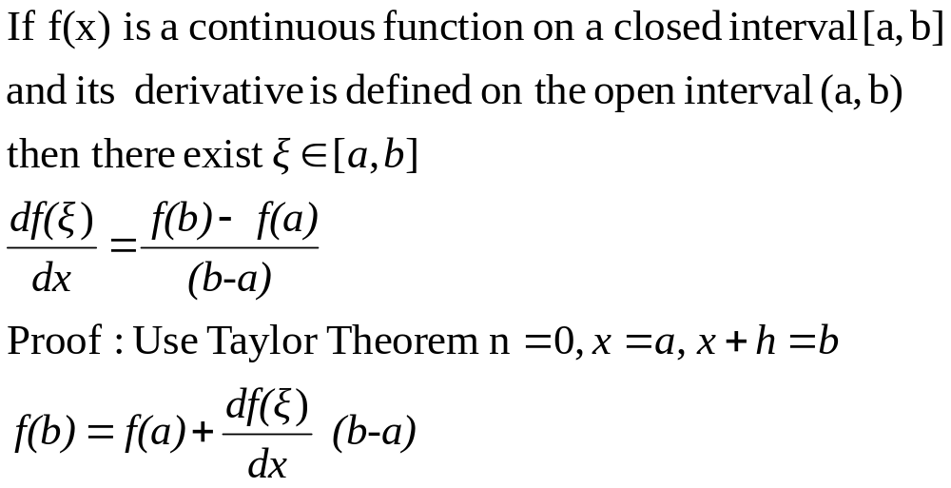
Mean Value Theorem

Slide 19
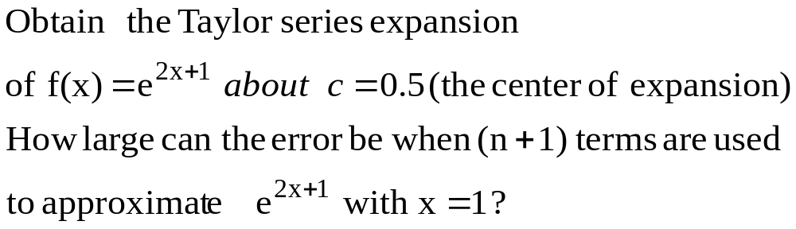
Example 5

Slide 20
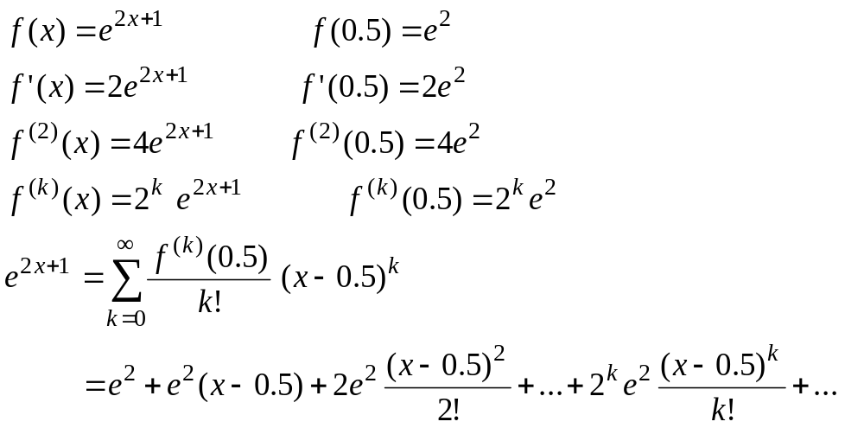
Example 5

Slide 21
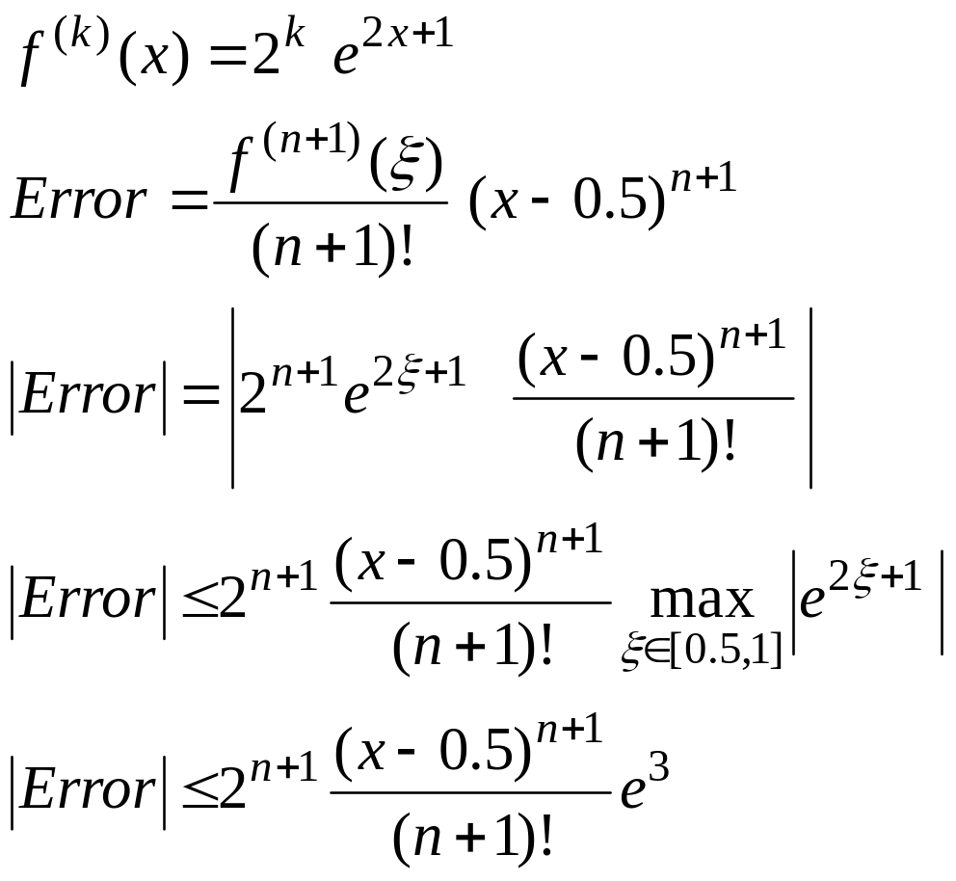
Example 5 Error term

Slide 22
Remark
In this course all angles are assumed to be in radian unless you are told otherwise

Slide 23
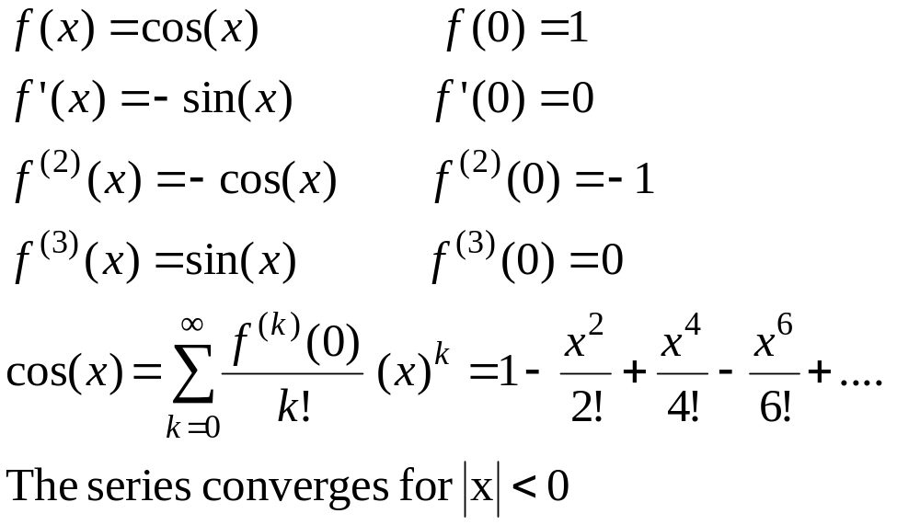
Taylor Series

